Slide 1
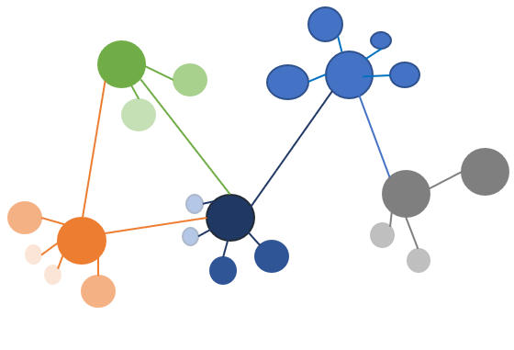
Spectral Clustering
Graph Based Clustering

Slide 2
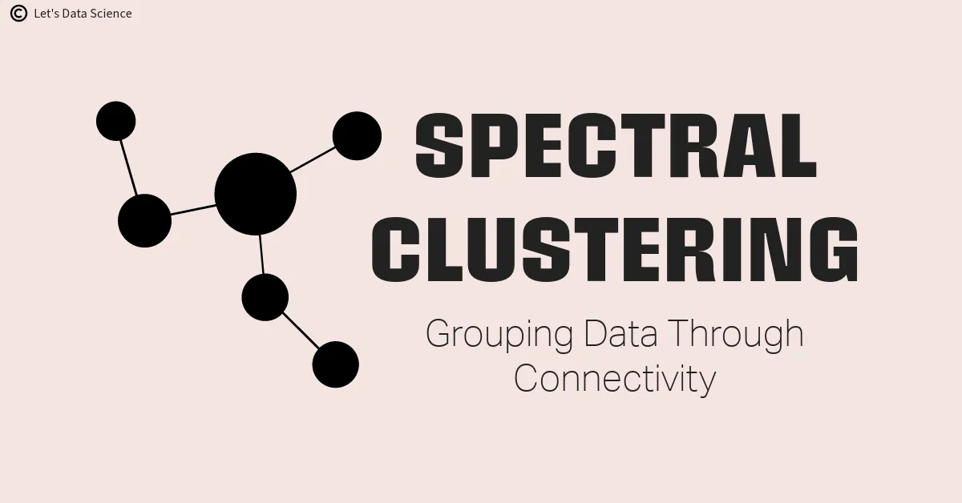
It Is A Unsupervised Learning Which Is Used To Find The Clusters In A Graph.
In Spectral Clustering, Data Points Are Treated As Nodes Of A Graph.
If We Able To Find The Sub-graph From The Given Graph, Then The Job Of Identifying The Clusters Is Done.
WHY WE NEED TO CLUSTER THE GRAPH?
Plenty Of Data Are In The Form Of Graphs.
Example: Social Networks Like Facebook And Twitter
If We Are Able To Find The Cluster, Then We Can See The Similar Interest Groups.
The goal of spectral clustering is to cluster data that is connected but not necessarily compact or clustered within convex boundaries.

Slide 3

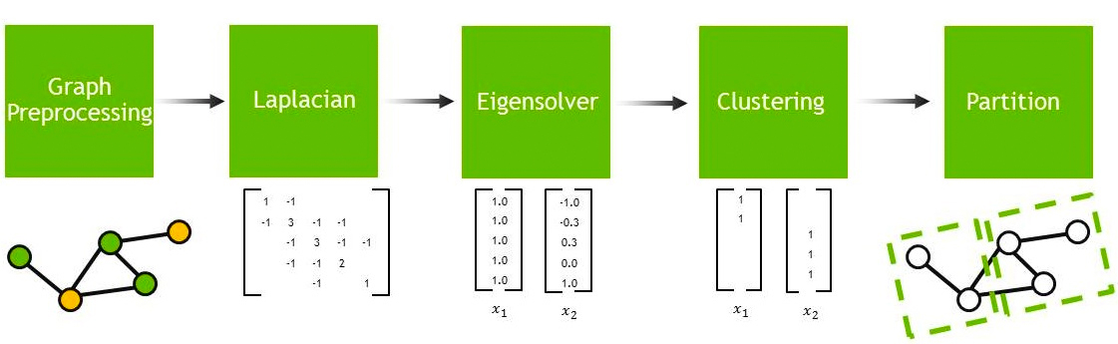
Steps for the Spectral Clustering:
Preprocessing - Using similarities matrix
Calculate eigenvalues and eigenvectors of the matrix
Assign the points to the cluster
Preprocessing:
Find the Laplacian Matrix for the Graph.
Use Adjacency Matrix and Degree Matrix to find the Laplacian Matrix
Calculate the Eigen Values and form Clusters
The second smallest eigen values partition the nodes in such way it pushes the set of values to one cluster and another set of values to another cluster

Slide 4
from sklearn.cluster import spectralclustering sc= spectralclustering(n_clusters = 2, assign_labels = “discretize”, random_state = 0).fit(x) y_sc = sc.fit_predict(x)
Advantages
Fast and Efficient Algorithm
Can be Applied to non-graphical data
Robust to Outliners and Noise
Disadvantages
Computationally expensive
Complexity

